Slide 1
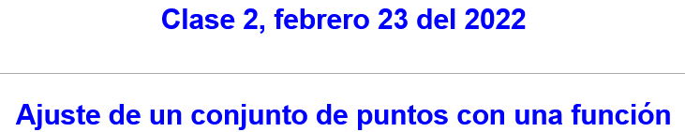
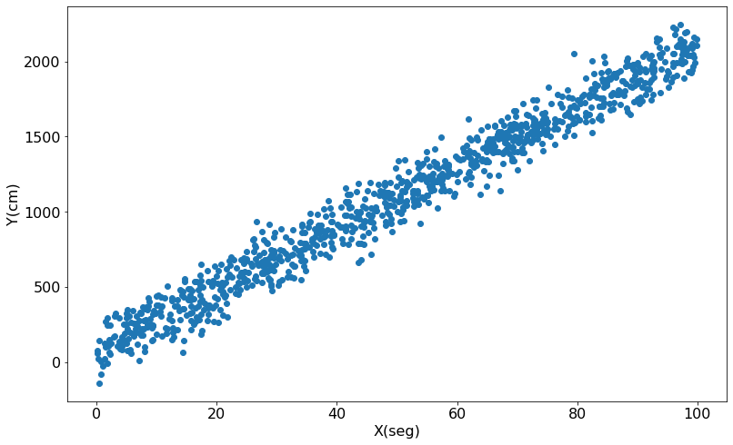
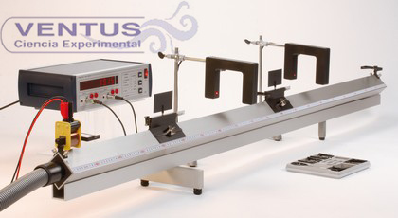

Slide 2
Supervised Learning

Slide 3

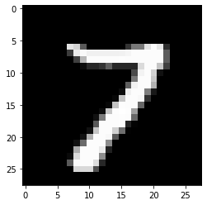
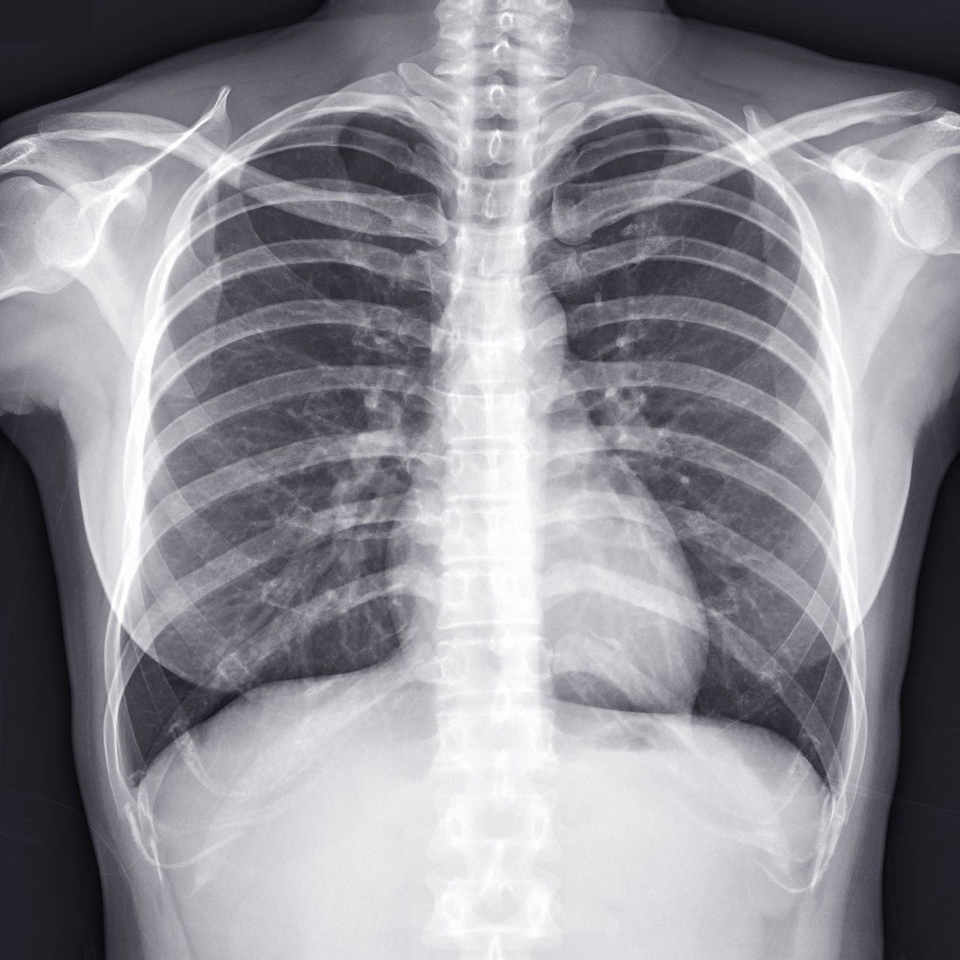

Image with an object:
X = pixels, Y = object in the image
X = pixels,
Y = México
X = pixels,
Y = siete
X = pixels,
Y =
(Woman, Third age)
X = pixels,
Y = Edema

Slide 4
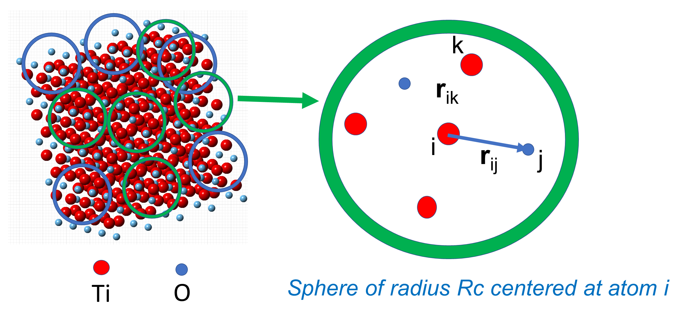
Mortality from diabetes with time
S1 = Glycated hemoglobin
S2 = High-density lipoprotein cholesterol
S3 =Impaired fasting glucose
S4 = Creatinine
S5 = Silky glucose
S6 =
X = (AGE, SEX, BP, S1, S2, S3,
S4, S5)
Y = Time(days)
PES (Potential Energy Surface)
X = Local order around an atom type. Around 50 to 78 values
Y = Total cluster energy

Slide 5
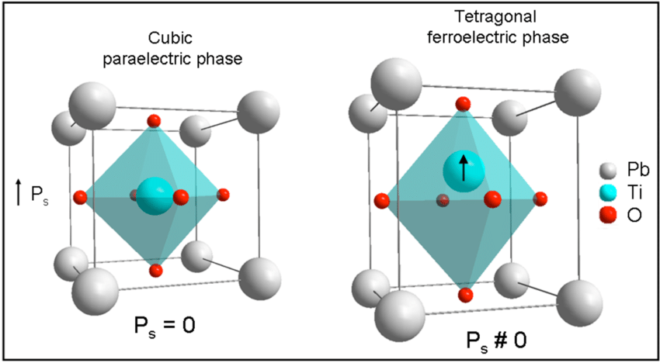
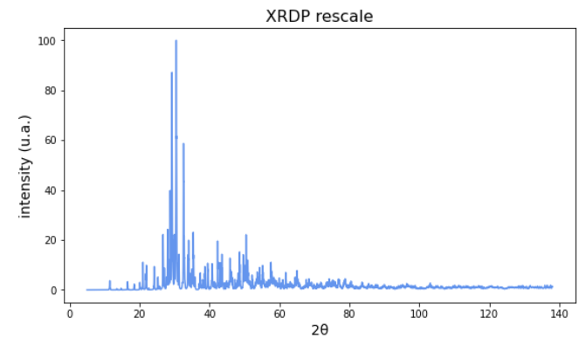
New Compounds:
X = atom size, atom valence, local distribution
Y = unit cell size,
symmetry of atomic distribution in the unit cell.
Crystalline structure:
X = X-ray diffraction intensity
Y = unit cell size,
symmetry of atomic distribution in the unit cell.

Slide 6
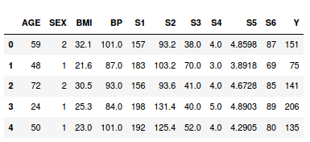
X
Y
Mortality from diabetes with time
S1 = Glycated hemoglobin
S2 = High-density lipoprotein cholesterol
S3 =Impaired fasting glucose
S4 = Creatinine
S5 = Silky glucose
S6 = Another serum property
PES (Potential Energy Surface)
X = (1.144, 3.498, 0.575, 0.985, 3.196, …. 0.129, 0.516, 0.187, 0.950)
Y = -63282.3731543148 Hartree

Slide 7
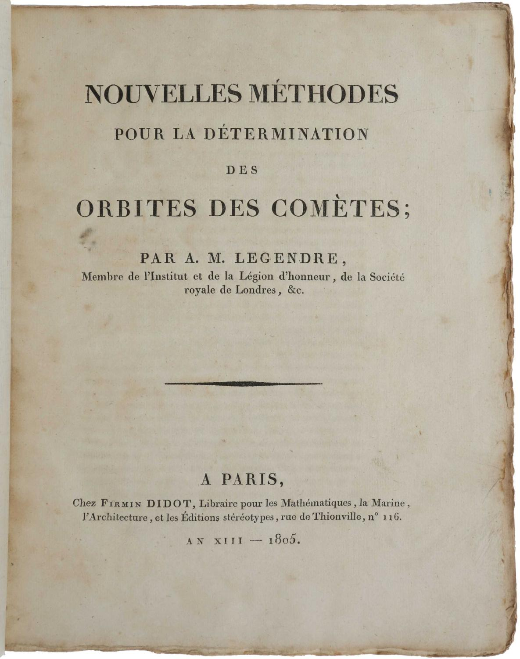
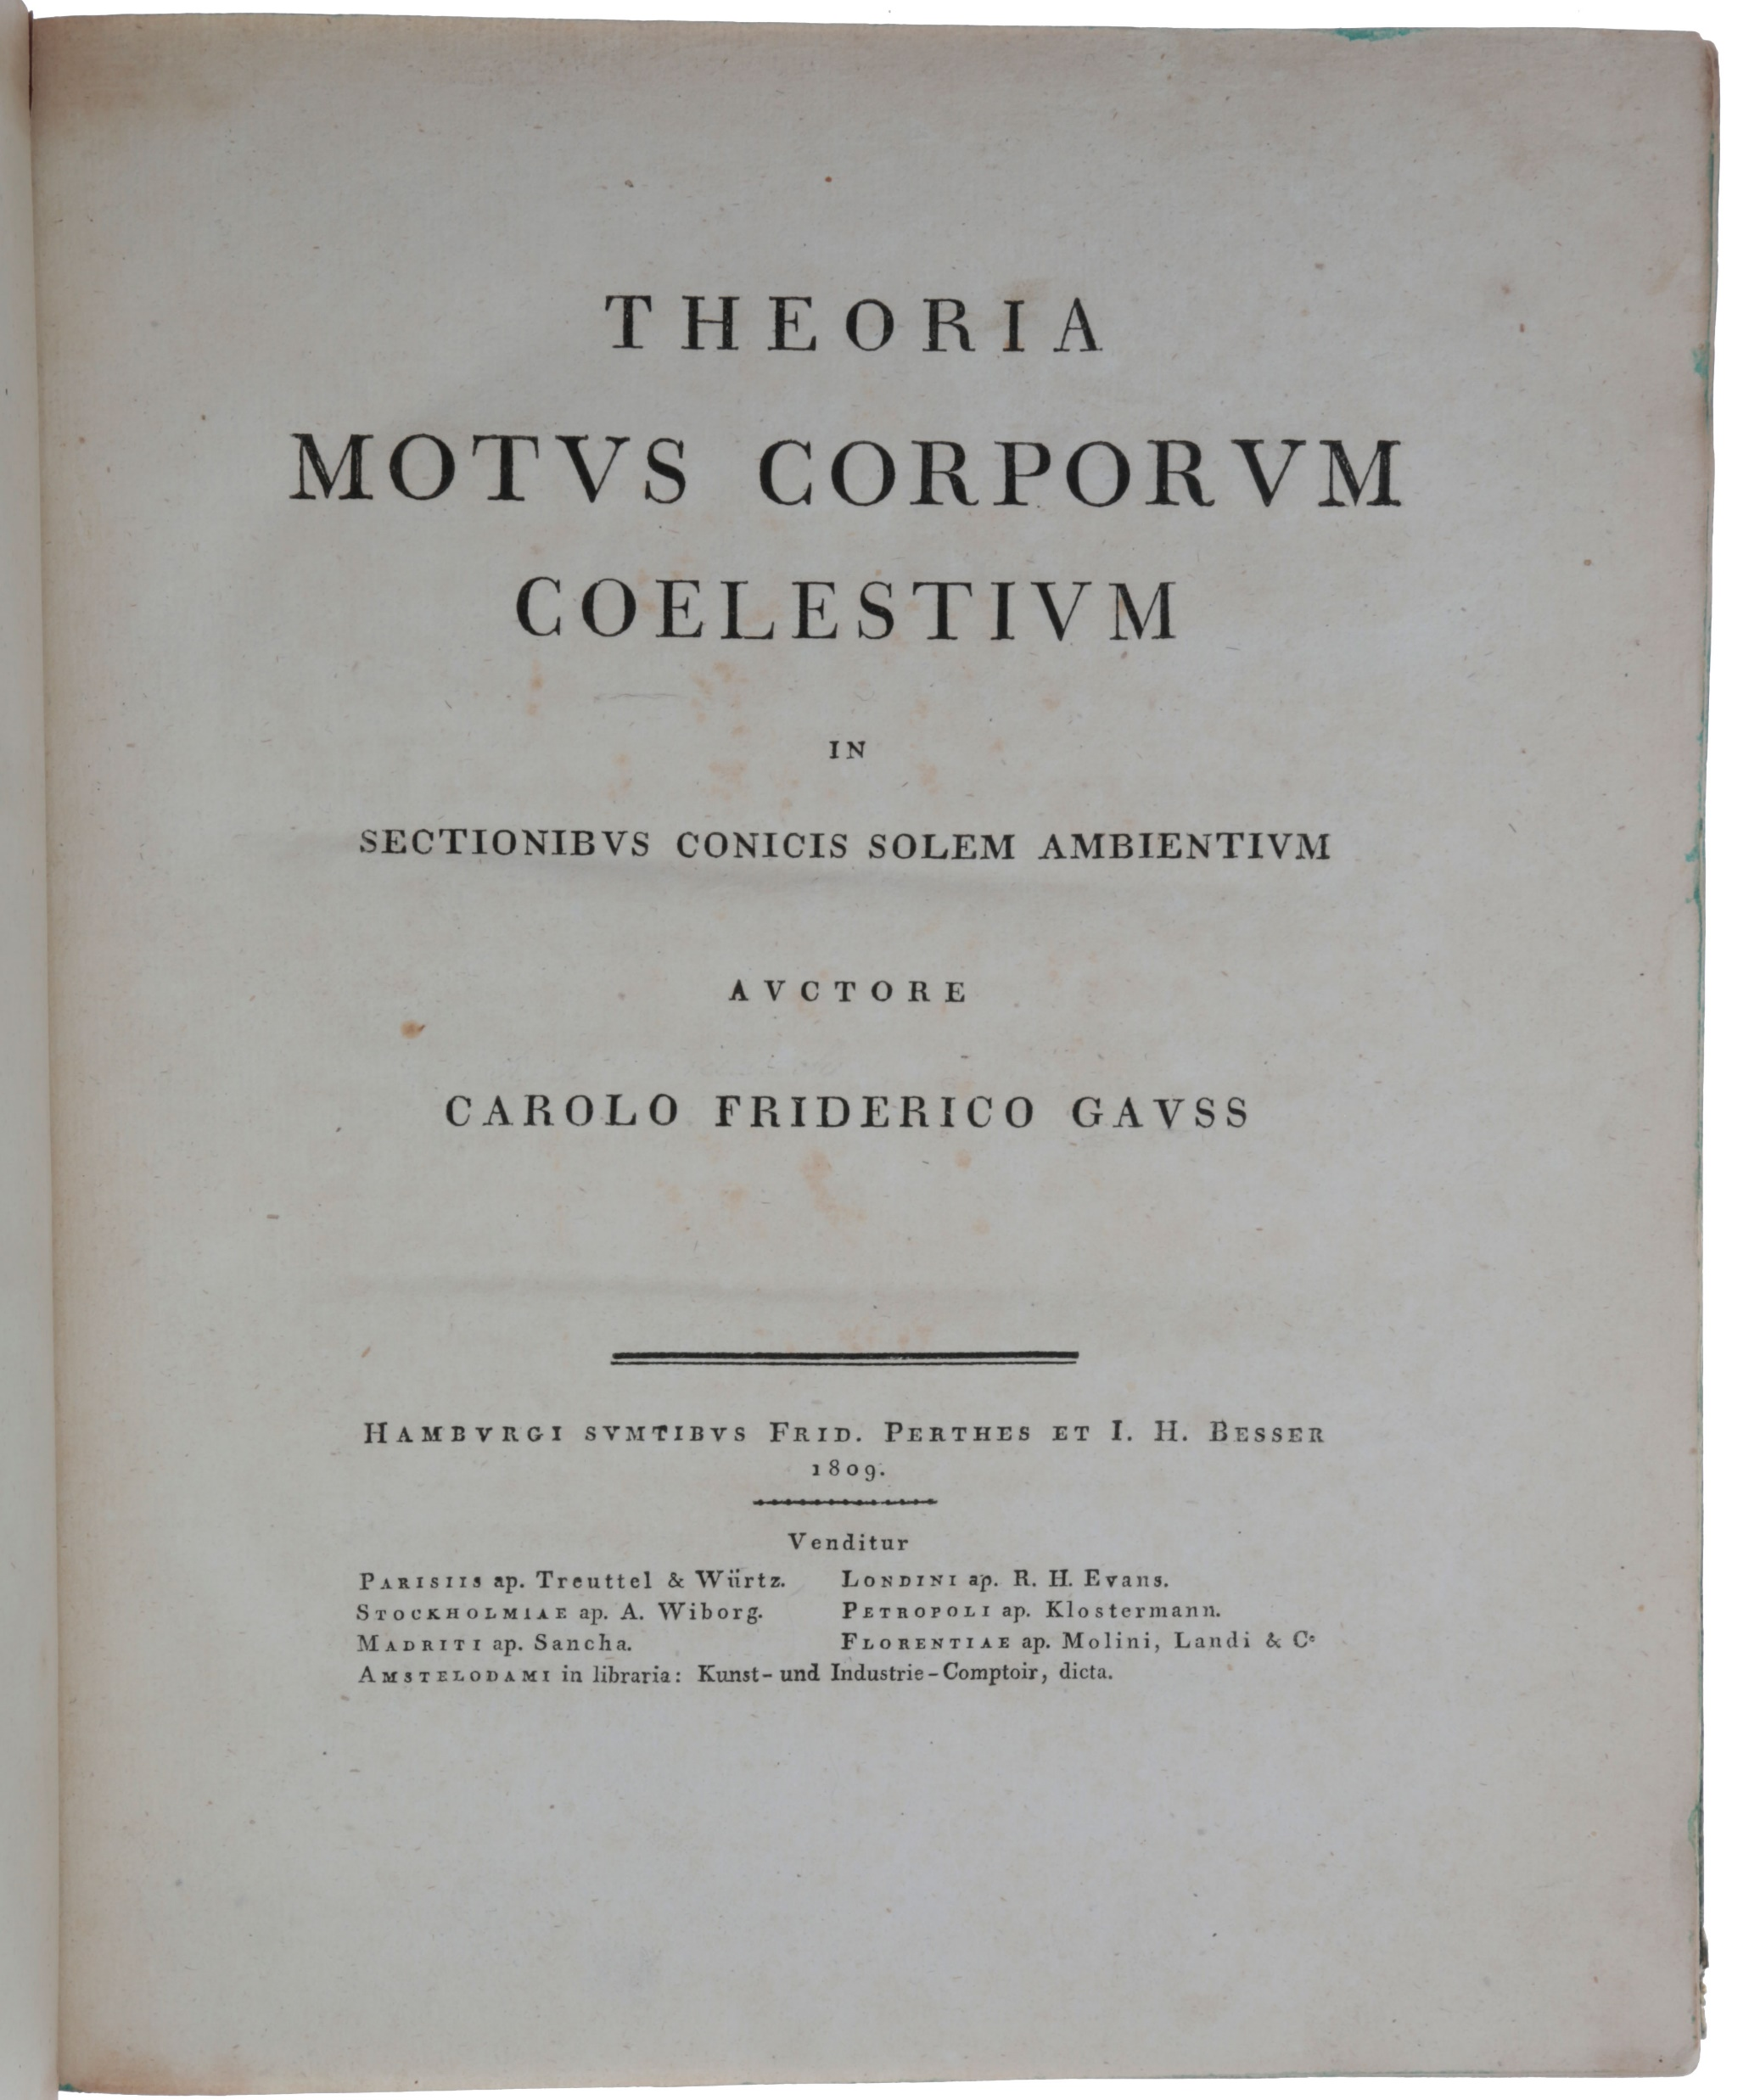
Curvas que describen los objetos celestes
obtenidas mediante su ajuste a un conjunto de mediciones

Slide 8
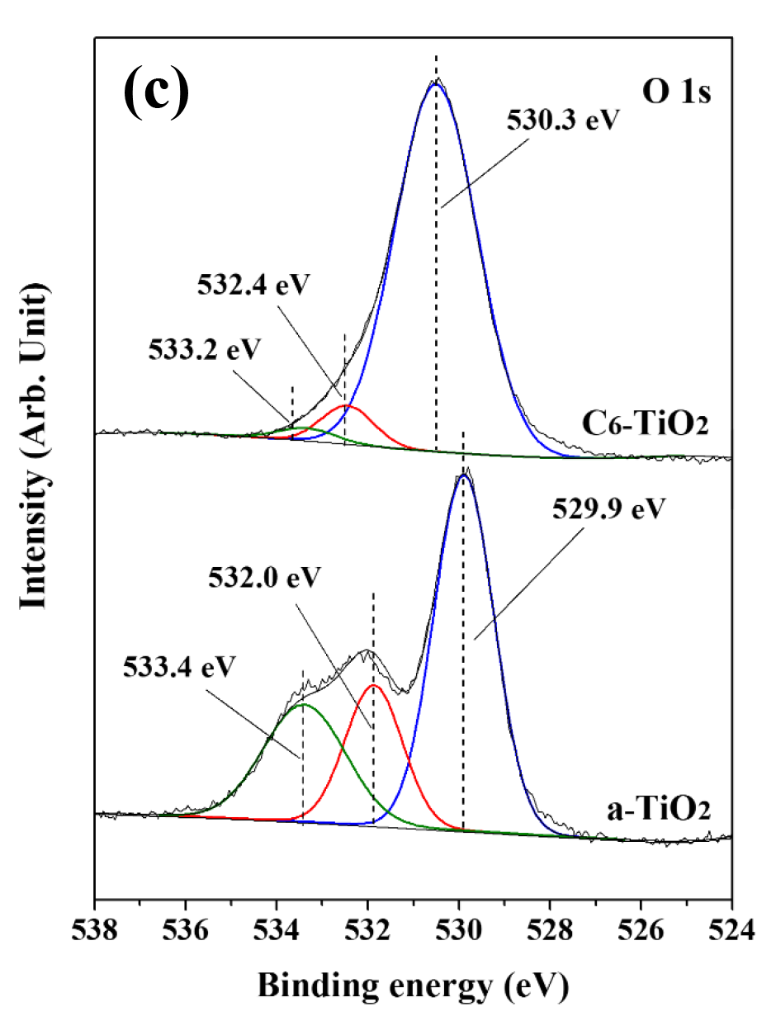
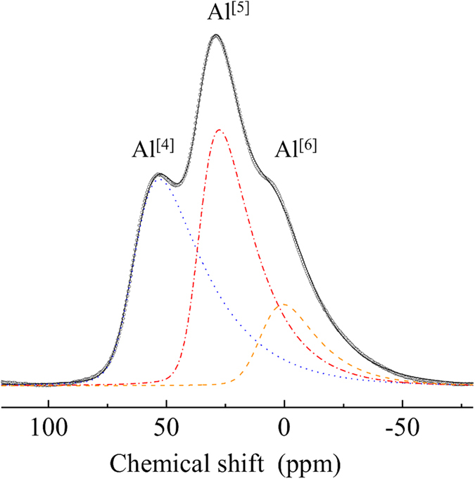
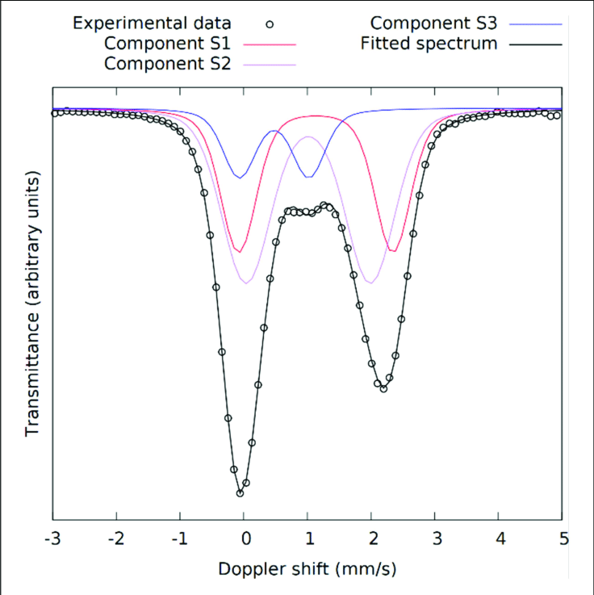
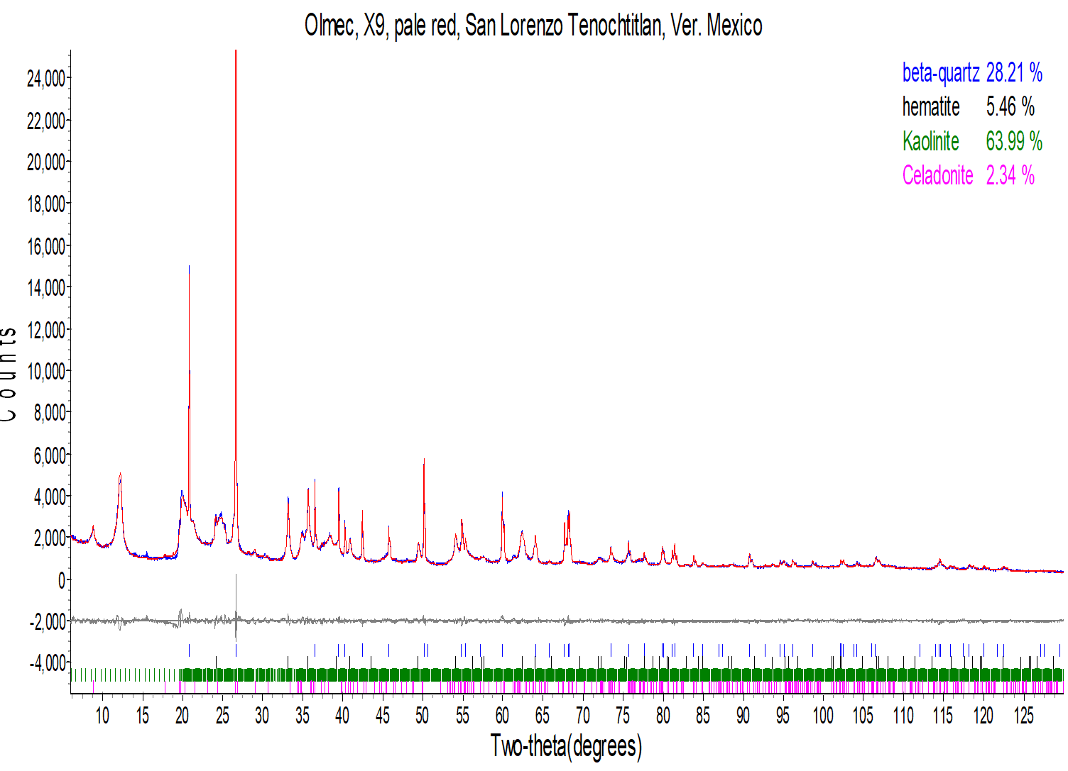
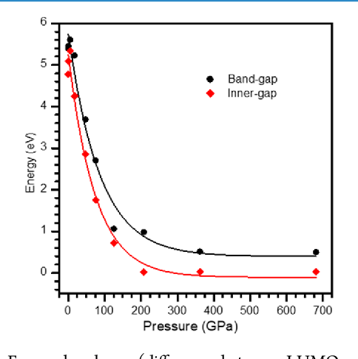
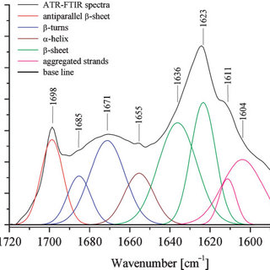
Resonancia Magnética nuclear
Espectroscopía Moessbauer
X-ray Photoelectron Spectroscopy
Espectroscopía infraroja
8
Difracción de rayos X, Rietveld

Slide 9
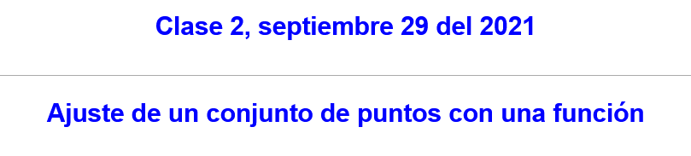

Slide 10
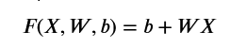
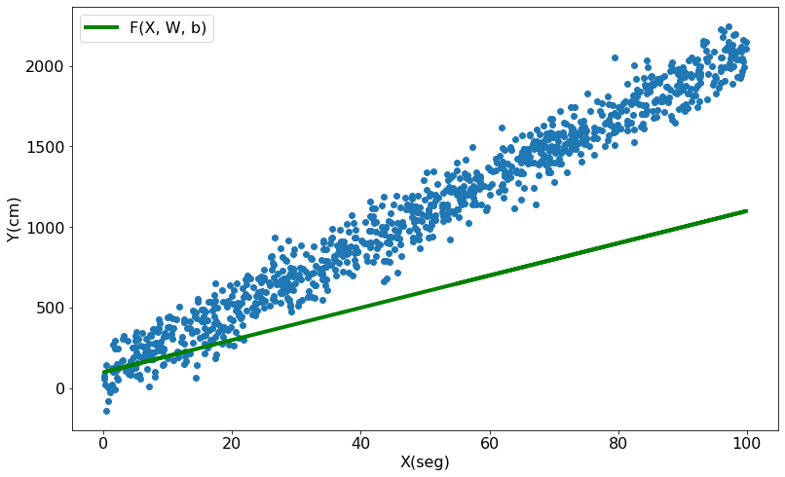
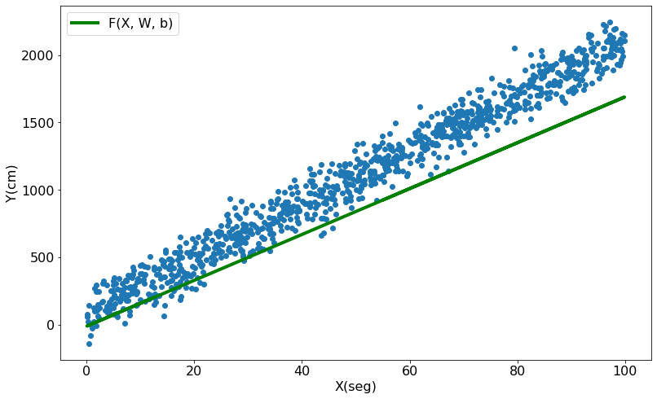
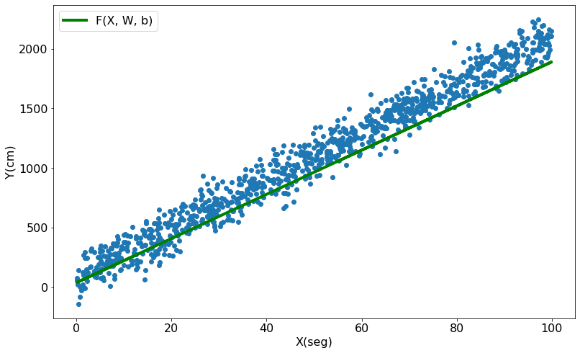
Métrica de evaluación
Error cuadrático medio
Y_ = 100.0 + 10.0 x
Y_ = -10.0 + 17.0 x
Y_ = 40.0 + 18.5 x

Slide 11
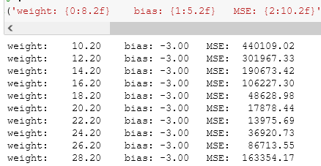
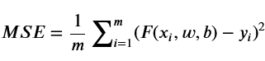
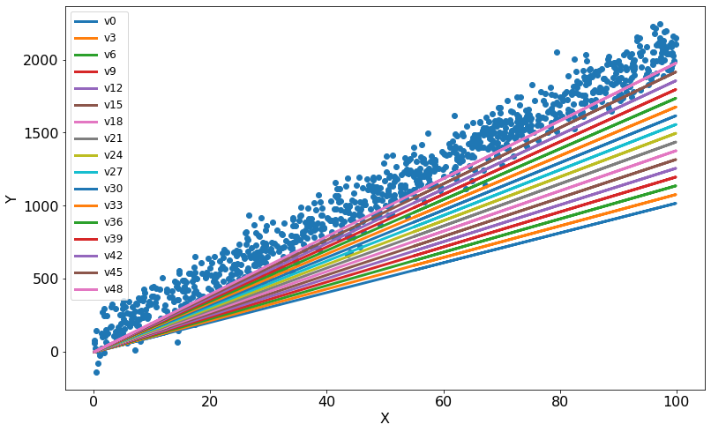
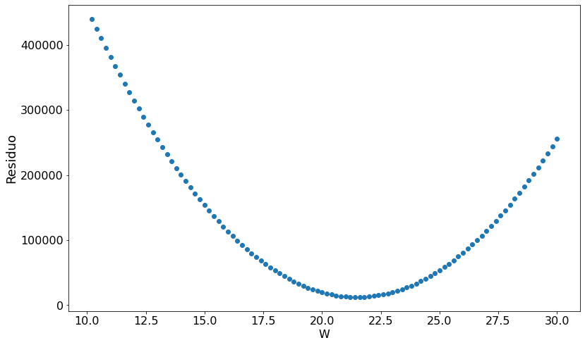
Error cuadrático medio
MSE (mean squared error)
MSE = 12315.05
Para W = 21.40,
b = -3.0

Slide 12
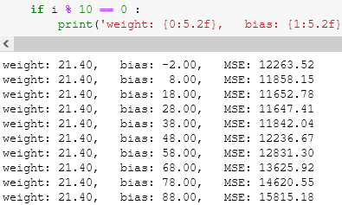
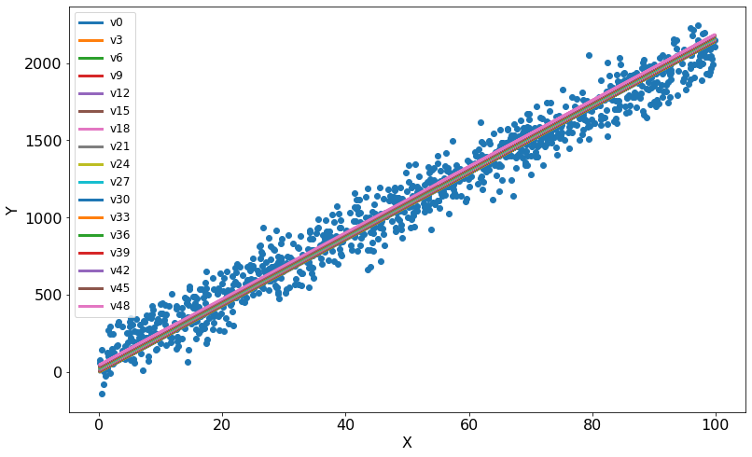
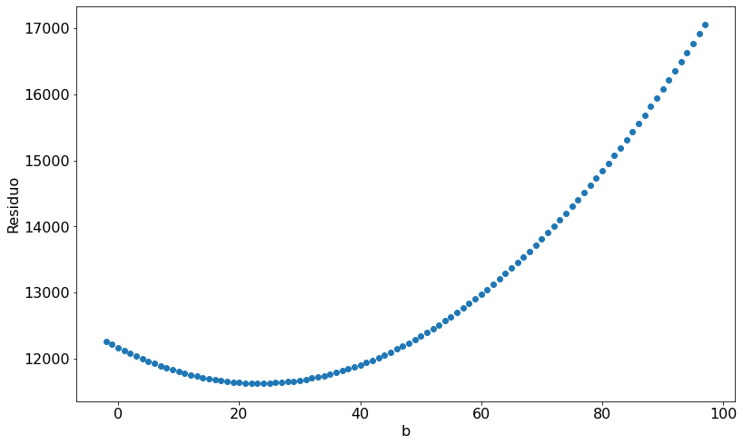
MSE = 11625.09
Para W = 21.40,
b = 23.0

Slide 13
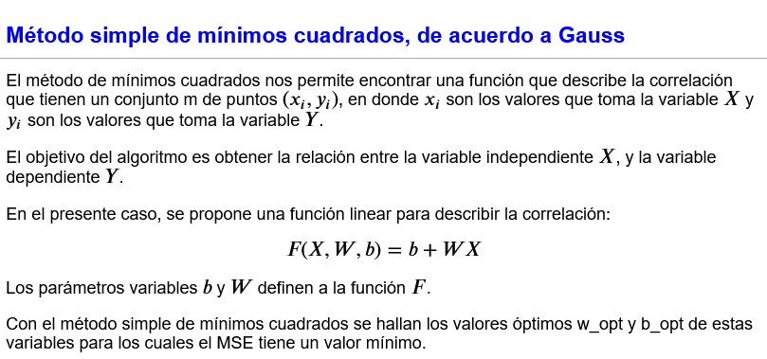

Slide 14
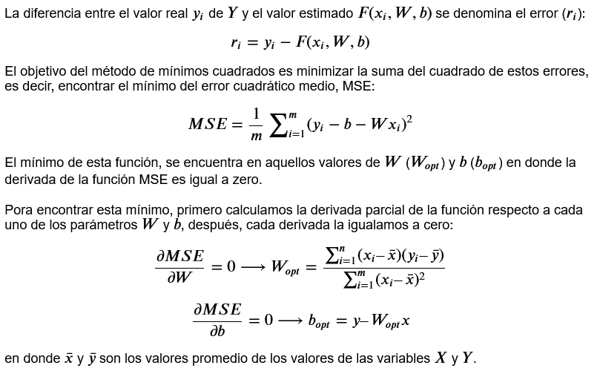

Slide 15
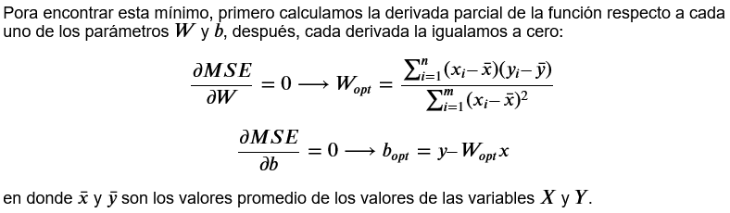
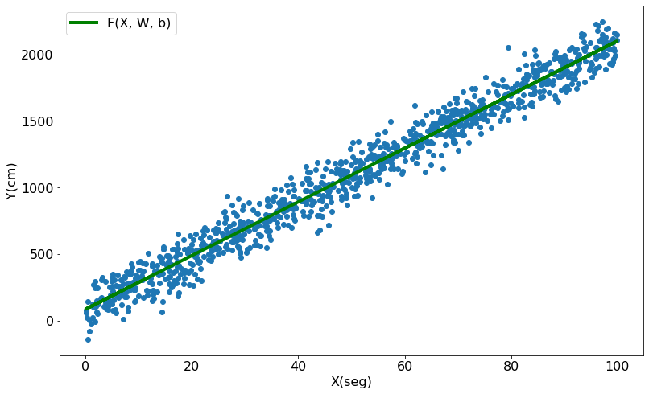
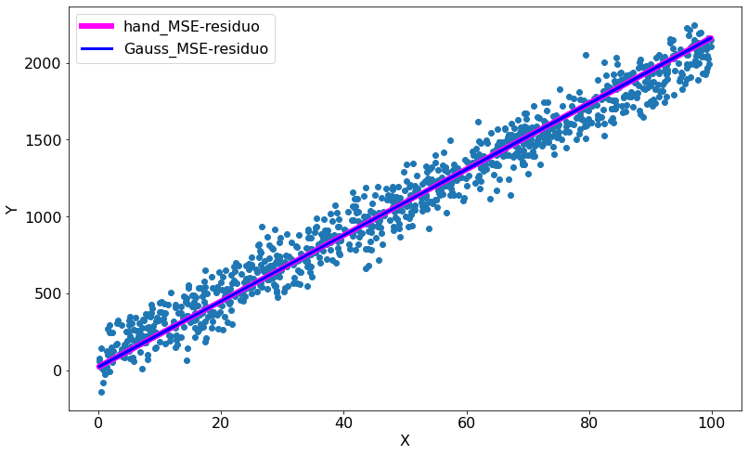

Slide 16
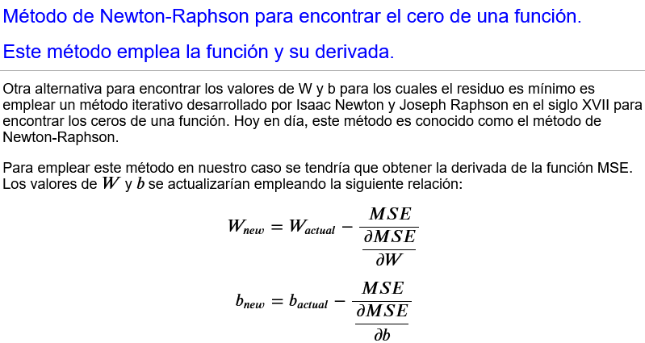
Métodos alternativas para encontrar los valores óptimos de W y b

Slide 17
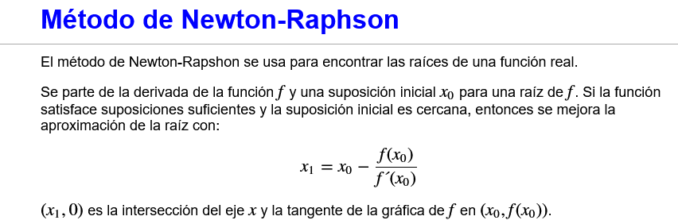
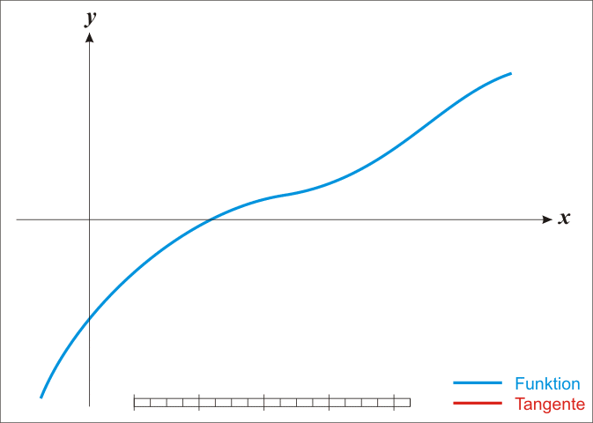

Slide 18
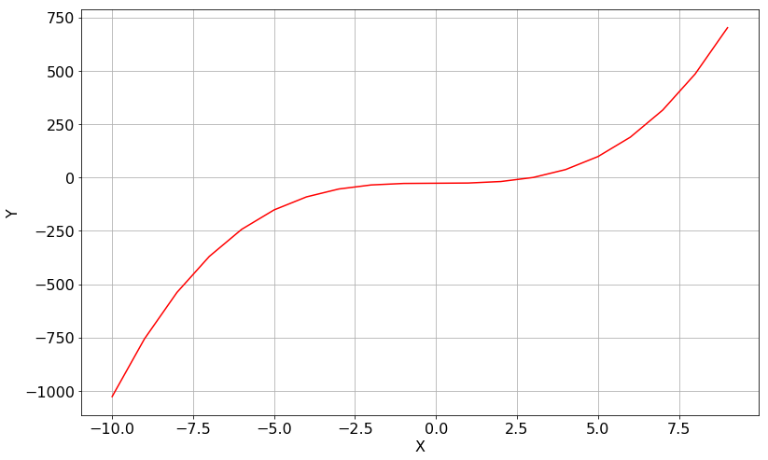
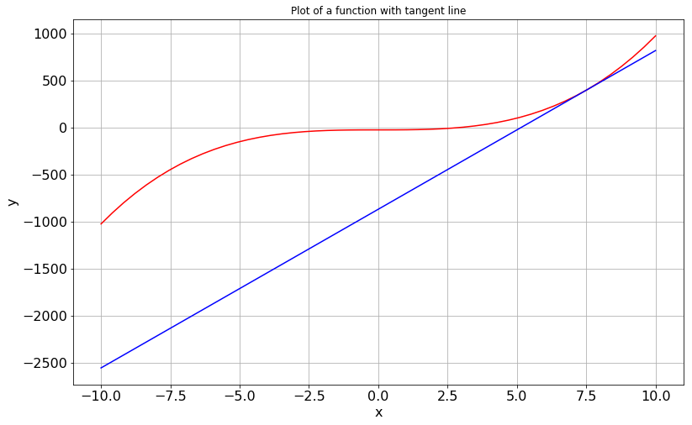
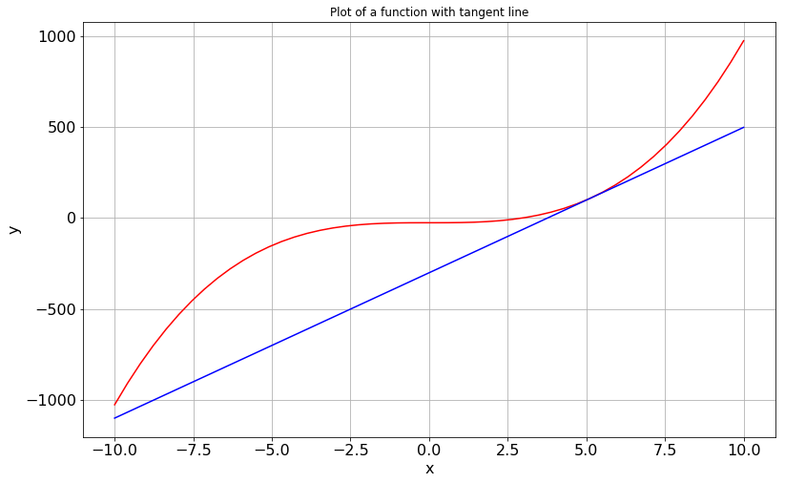
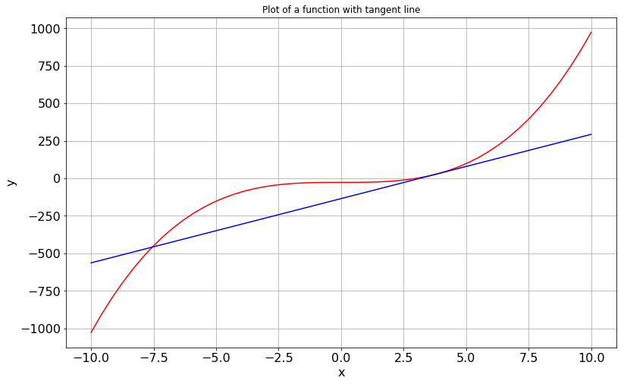
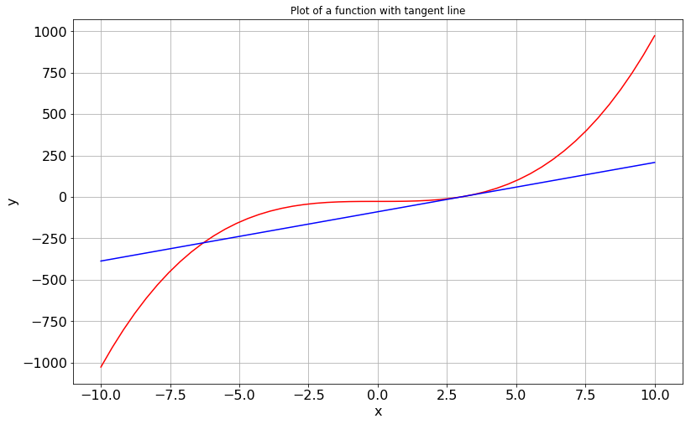
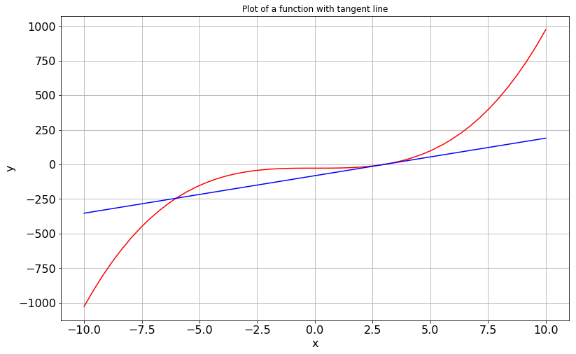
Newton-Raphson
Gradiente descendente

Slide 19
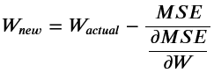
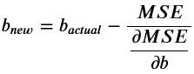
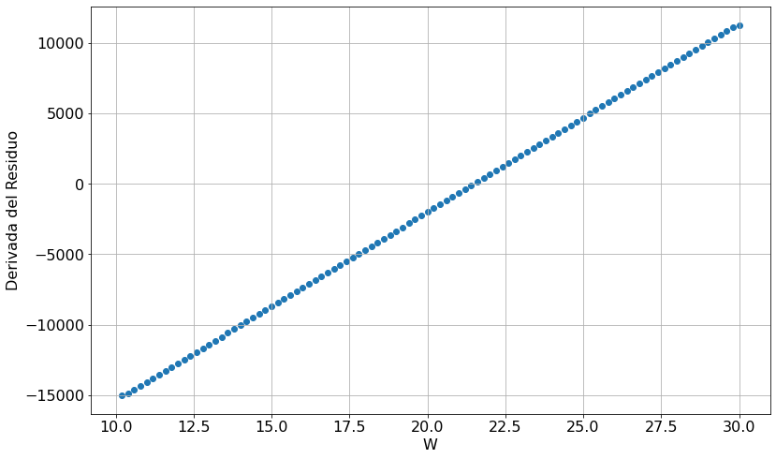
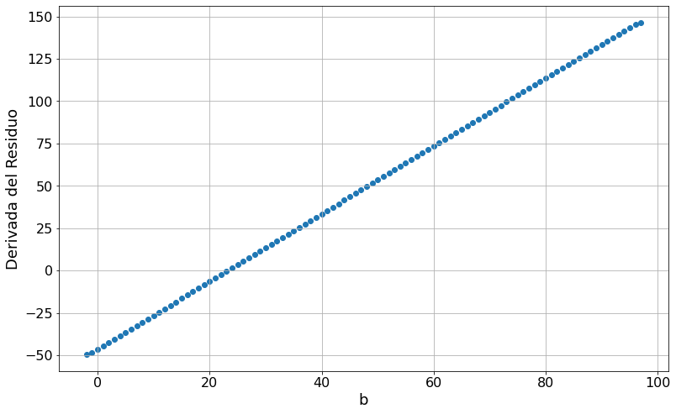
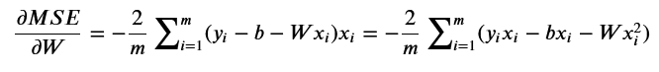
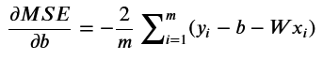

Slide 20
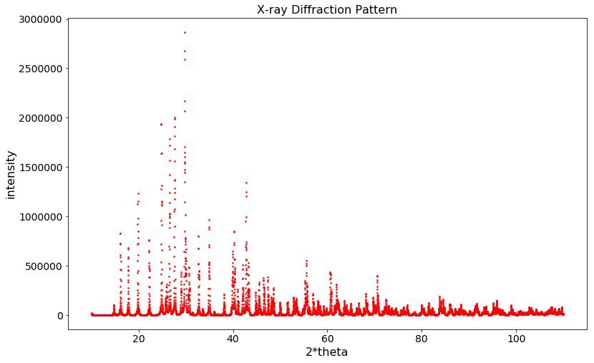





20

Slide 21

S_{y} =  w_{i} (y_{i} - y_{ci})²
54 pesos refinados
21

Slide 22




Métodos alternativas para encontrar los valores óptimos de W y b
Cauchy, 18 de octubre de 1847,
in his Compte Rendu `a l’Acad´emie des Sciences
Para nuestro caso esto correspondería a

Slide 23
23

Slide 24
Resumen de los métodos de análisis
Puntos (X, Y)
X
Y
MSE(W, b,X,Y)
F(W,X) = b+WX
W, b

Slide 25

Tarea (4 parámetros)
Movimiento de un cuerpo sujeto a una fuerza

Slide 26

Tarea (4 parámetros)

Slide 27

156,710 parameters

Slide 28




